Slide 1

Blinkit Sales Analysis
Comprehensive insights into sales performance, customer preferences, and outlet effectiveness across the Blinkit platform.
-Rosewal Almeida

Slide 2
Performance Overview
KEY METRICS
$1.20M
141
3.9
Total Sales
Average Sales
Average Rating
Revenue generated across all outlets and product categories
Mean transaction value per item sold
Customer satisfaction score across all products

Slide 3
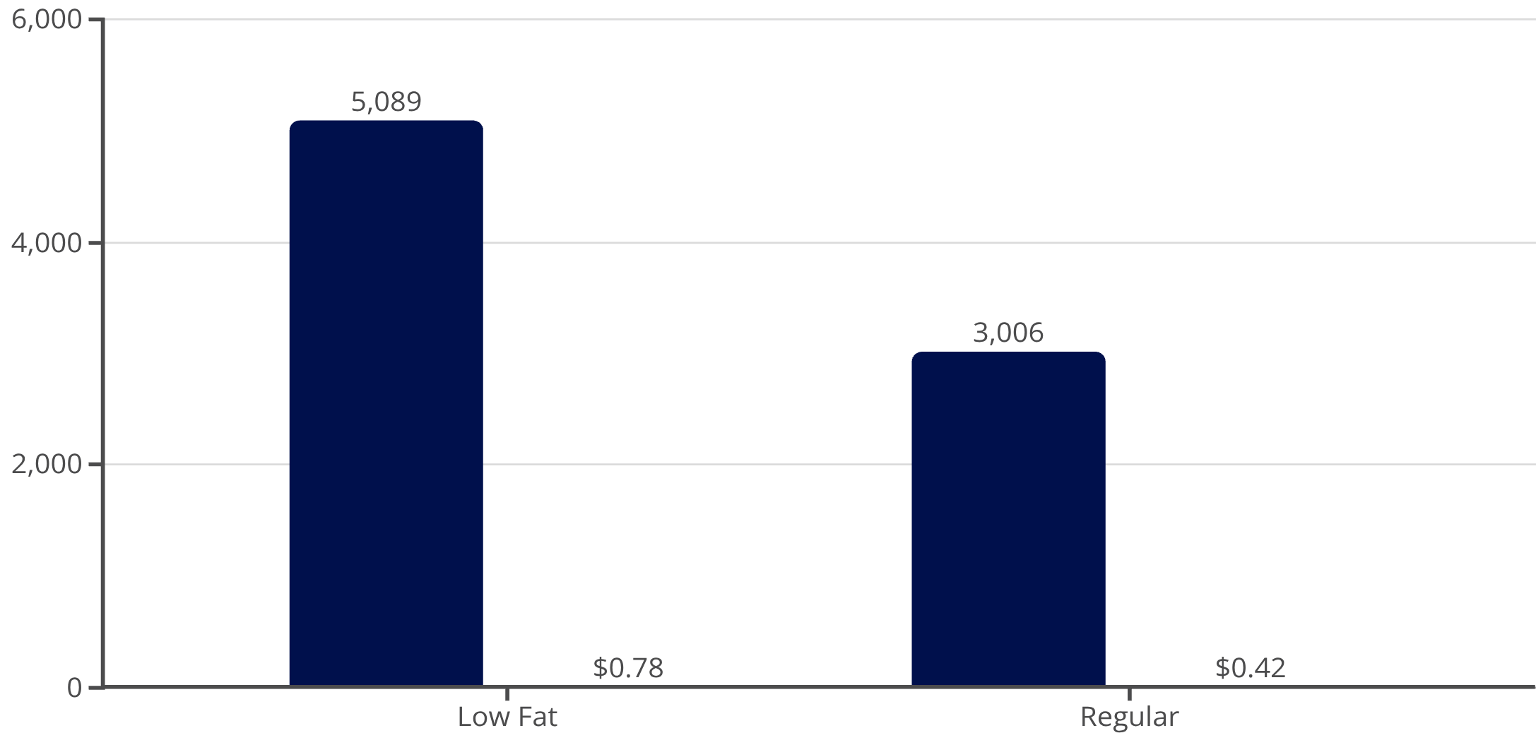
Fat Content Analysis
Customer Preferences
Low-fat products dominate with 5,089 items generating $0.78M in sales. Regular fat items account for 3,006 products with $0.42M revenue.
Both categories maintain consistent 3.9 average ratings, indicating quality satisfaction across fat content types.
Item Count
Sales (Millions)

Slide 4






Top Performing Item Types
PRODUCT CATEGORIES
Fruits & Vegetables
Snack Foods
Household Items
1,200 items | $175K sales | 3.9 rating
910 items | $136K sales | 3.9 rating
1,232 items | $178K sales | 3.9 rating
Dairy Products
Canned Goods
Frozen Foods
682 items | $101K sales | 3.9 rating
649 items | $93K sales | 3.9 rating
856 items | $119K sales | 3.9 rating

Slide 5
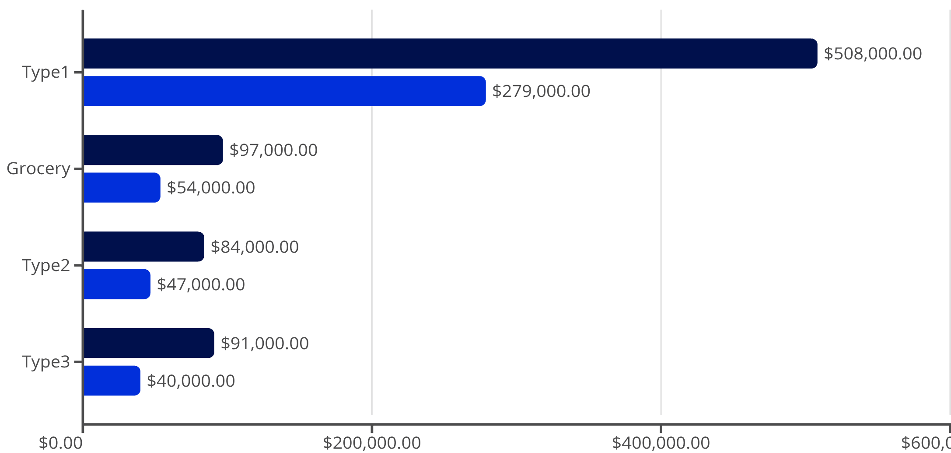
Outlet Type Performance
Sales Distribution
Supermarket Type1 outlets lead with $787K in total sales across both fat content categories. Grocery stores generate $151K, while Type2 and Type3 supermarkets contribute $131K and $131K respectively.
Low-fat products consistently outperform regular items across all outlet types, with Type1 supermarkets showing the strongest preference at $508K vs $279K.
Low Fat
Regular

Slide 6

Location Type Insights
Tier 3 Cities
Tier 2 Cities
Tier 1 Cities
2,793 low-fat items ($472K) and 1,350 regular items ($220K). Highest volume market with strong low-fat preference.
1,553 low-fat items ($248K) and 1,113 regular items ($156K). Balanced distribution with consistent ratings.
743 low-fat items ($58K) and 543 regular items ($46K). Smaller market with proportional sales patterns.

Slide 7
Strategic Recommendations
Expand Low-Fat Range
Focus on Tier 3
Optimize Medium Outlets
Capitalize on strong customer preference with 63% of items and 65% of sales from low-fat products.
Prioritize Tier 3 cities where sales volume is highest and customer base most established.
Medium-sized outlets drive 42% of sales invest in this proven format for expansion.

Slide 8

Quality Consistency
3.9
Key Insight
Universal Rating
The uniform 3.9 rating across 8,095 items, all outlet types, and location tiers demonstrates exceptional operational consistency.
Consistent customer satisfaction across all categories, outlet types, and locations.
This reliability builds customer trust and supports sustainable growth across diverse market segments.

Slide 9

Key Takeaways
$1.20M Total Revenue
Low-Fat Dominance
Strong performance with consistent quality ratings
65% of sales from health-conscious product choices
Tier 3 Leadership
Quality Excellence
Highest volume market driving platform growth
3.9 rating maintained across all segments

